Slide 1
Use Case walk-through for Automation Platform Development
Detailed capture of command-response dependency

Slide 2
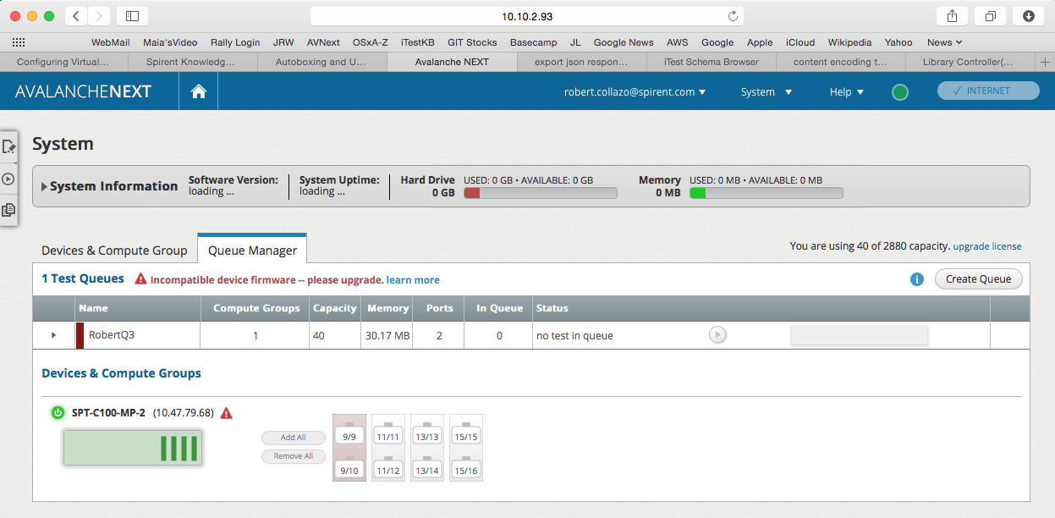
AVNext UI
Starting state:
(1) Test Queue created: “RobertQ3”
(1) Port Group Reserved: Group ID #9

Slide 3
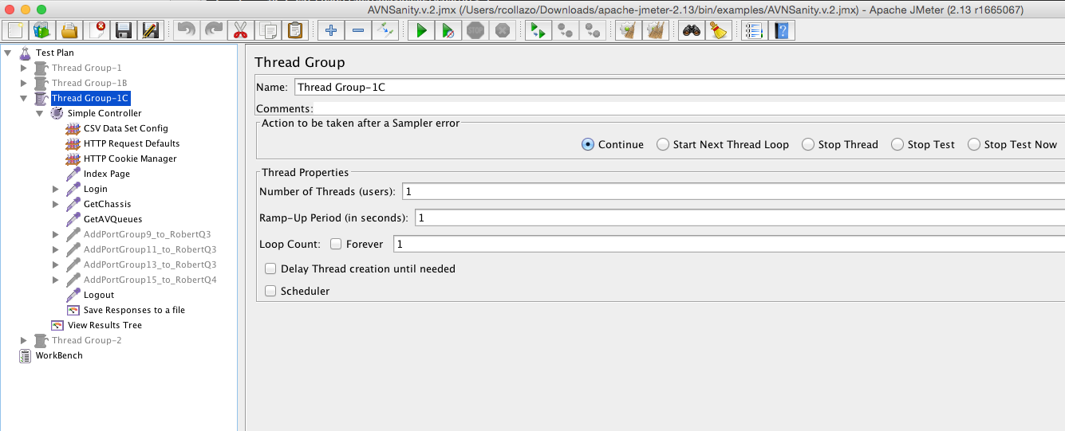
Run GET API’s:
GET /av_chassis
GET /av_queues
NOTE: AddPortGroup steps are disabled (grey’d)

Slide 4
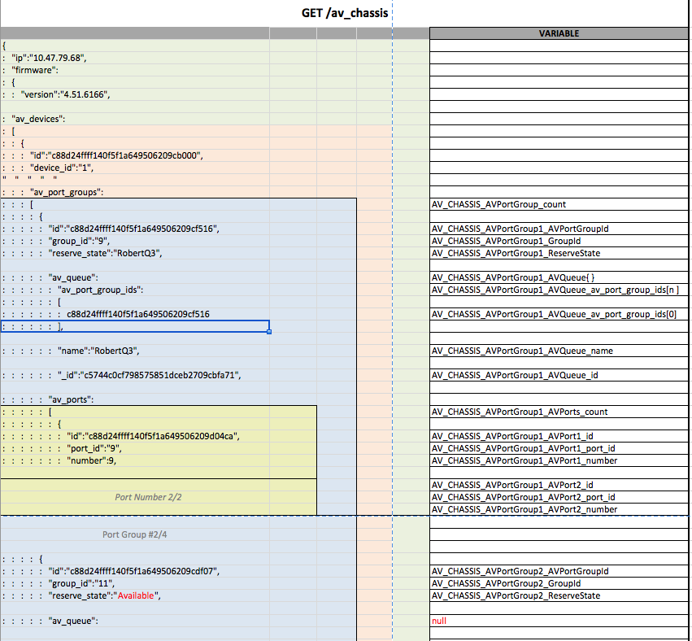
GetChassis response (partial display):
Variables defined for fields that contain global dependencies
Note ‘Red’ highlights

Slide 5
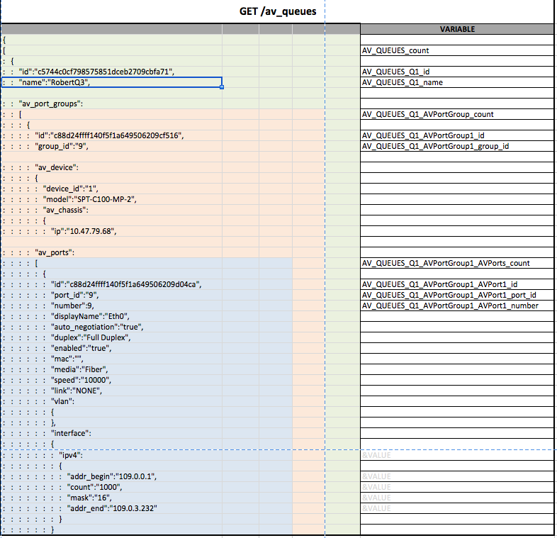
GetQueues response (partial display):
Variables defined for fields that contain global dependencies
Note ‘Red’ highlights

Slide 6
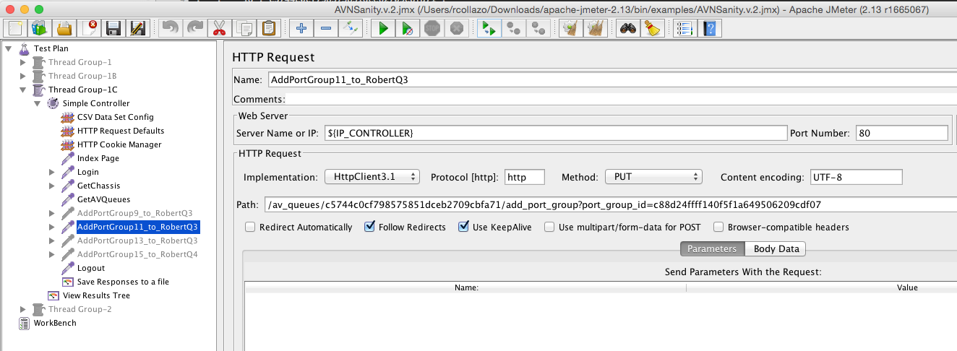
Adding Port “Group ID” #11 to Queue: “RobertQ3”
PUT /av_queues/ $AV_QUEUES_Q1_id/add_port_group_id=$AV_CHASSIS_AVPortGroup2_AVPortGroupId

Slide 7
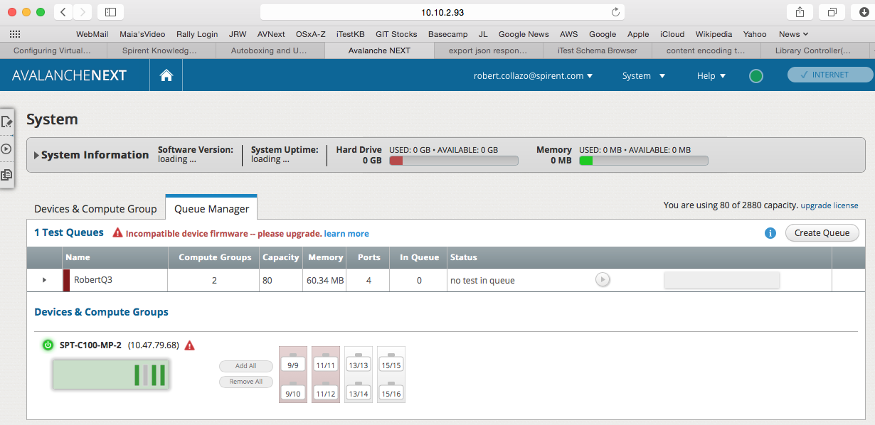
AVNext UI
Port Group #11 has been added to Test Queue: “RobertQ3”

Slide 8
Run GET API’s:
GET /av_chassis
GET /av_queues
NOTE: AddPortGroup steps are disabled (grey’d)

Slide 9
Next (5) Slides: Diffs
Compare JSON Response of GetChassis command – before and after Port Group #11 added to Queue: “RobertQ3”

Slide 10
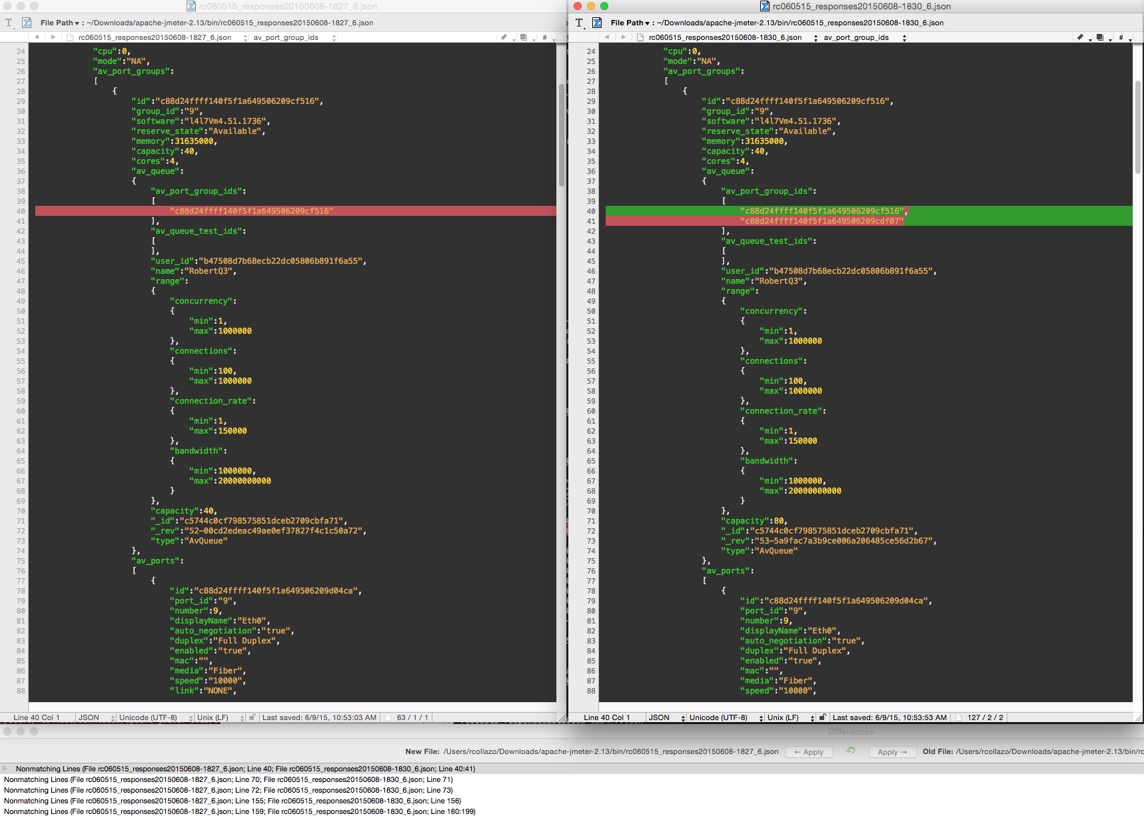

Slide 11
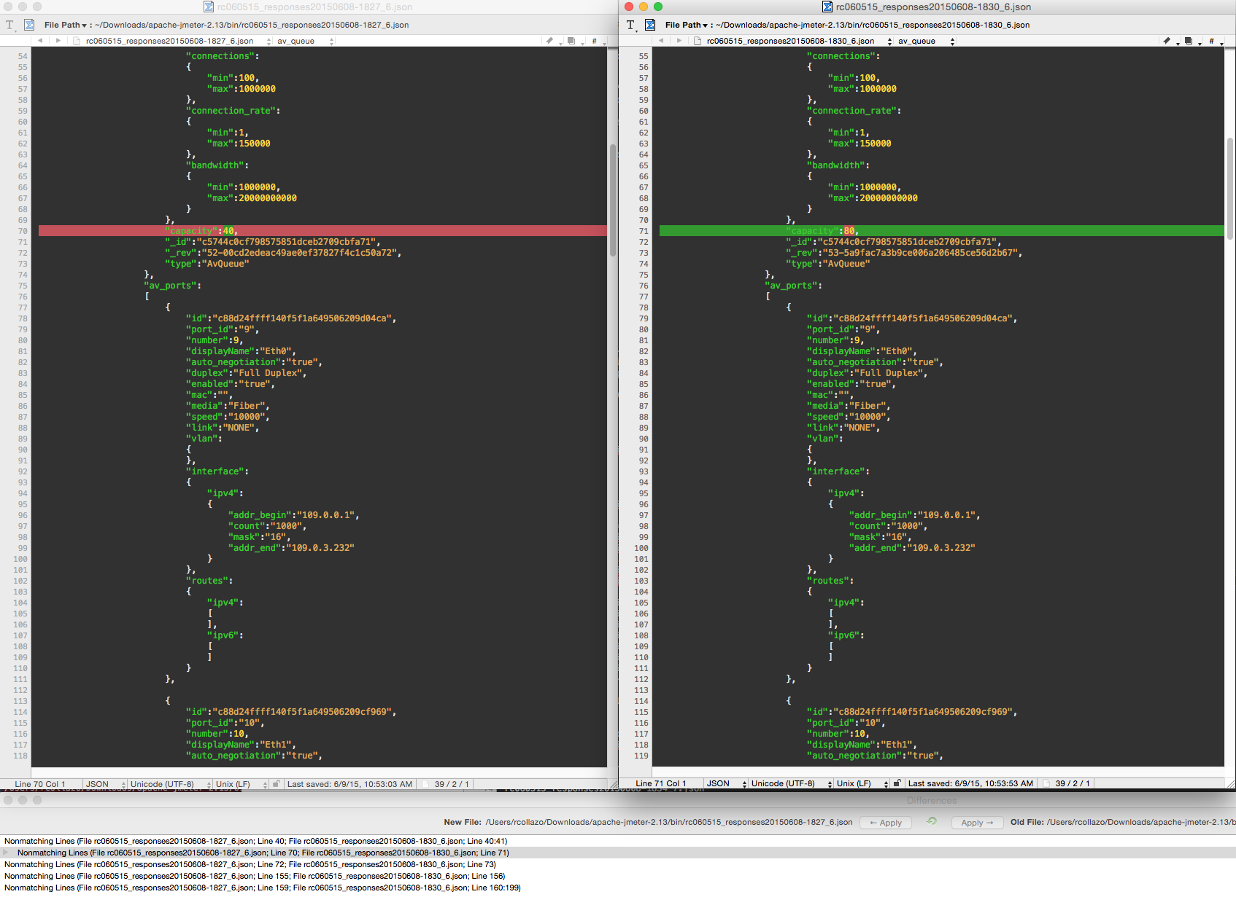

Slide 12
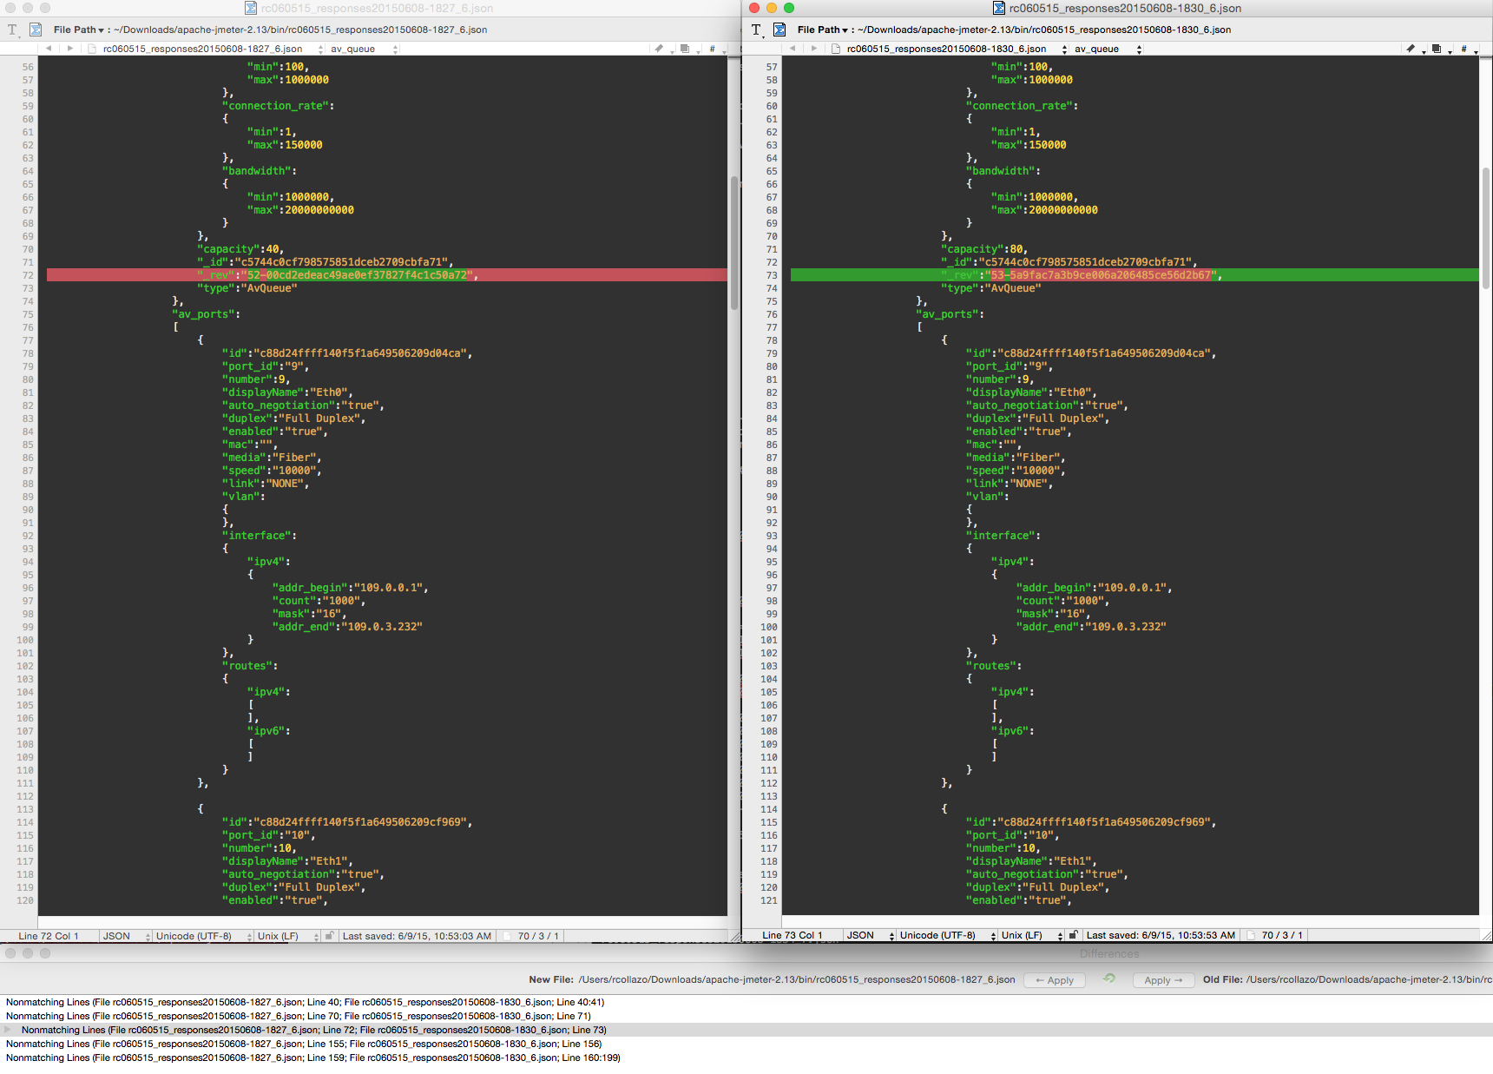

Slide 13
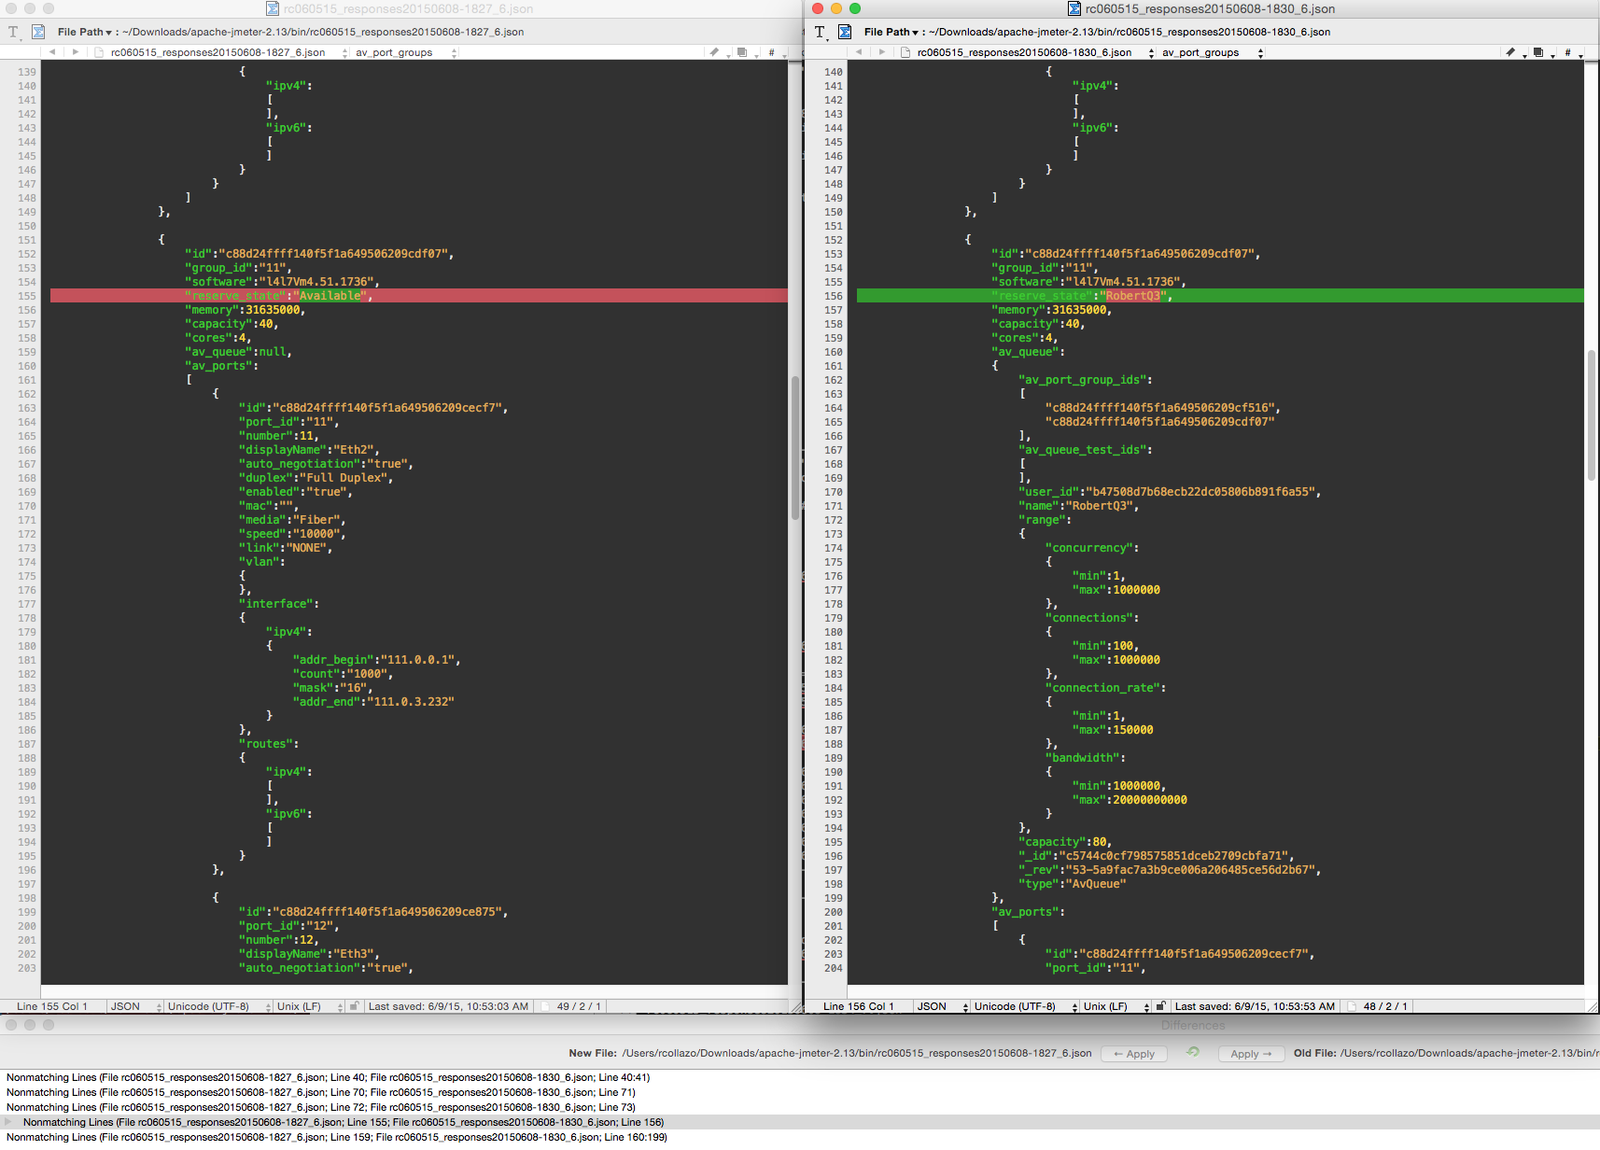

Slide 14
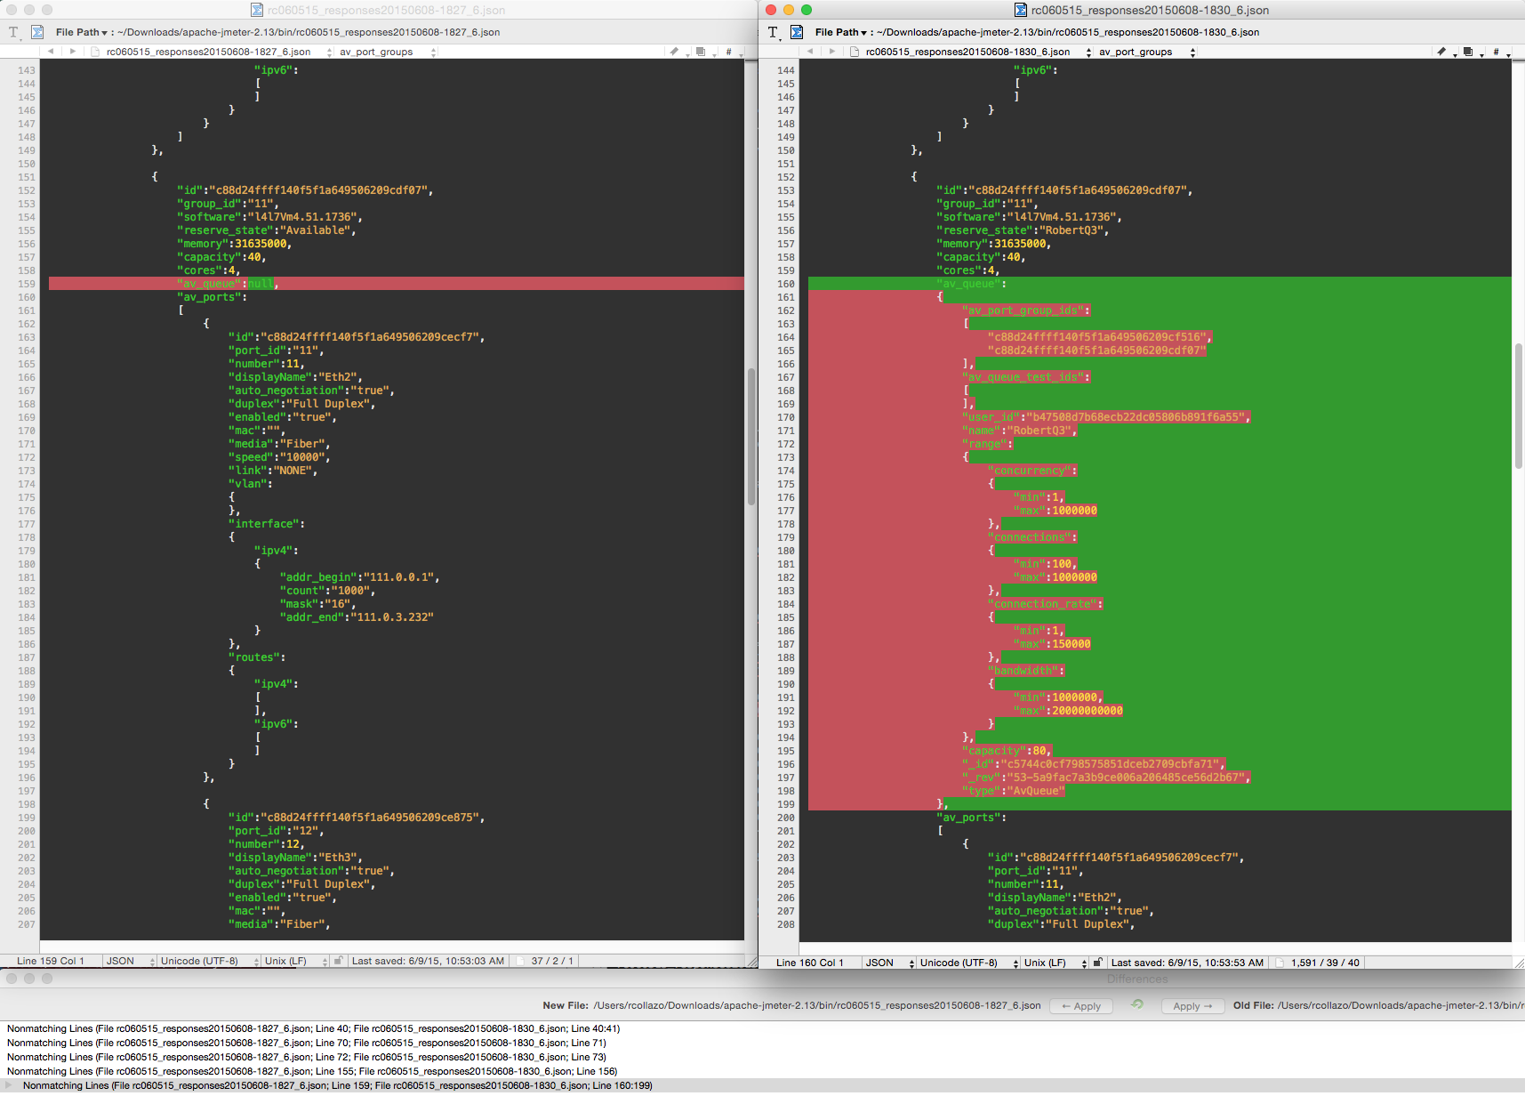

Slide 15
Next (1) Slide: Diffs
Compare JSON Response of GetAVQueues command – before and after Port Group #11 added to Queue: “RobertQ3”

Slide 16
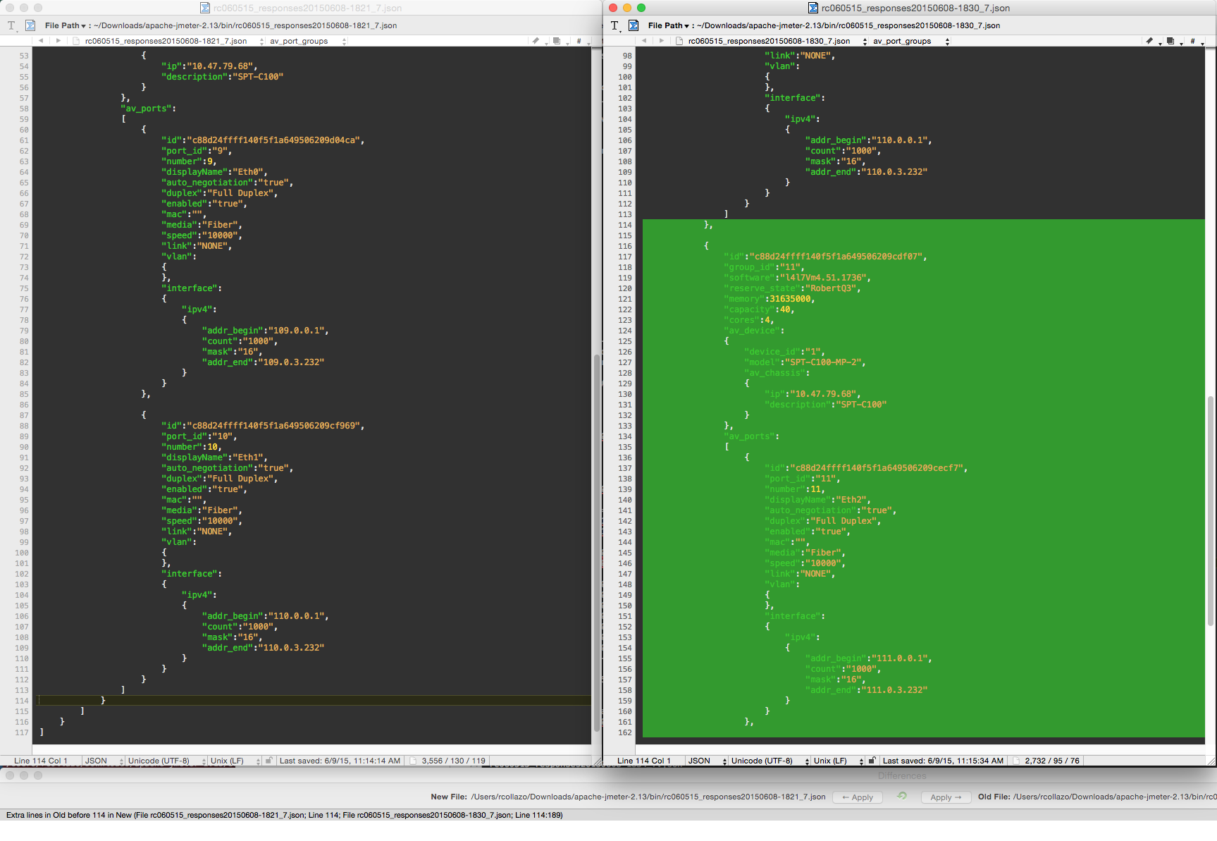

Slide 17
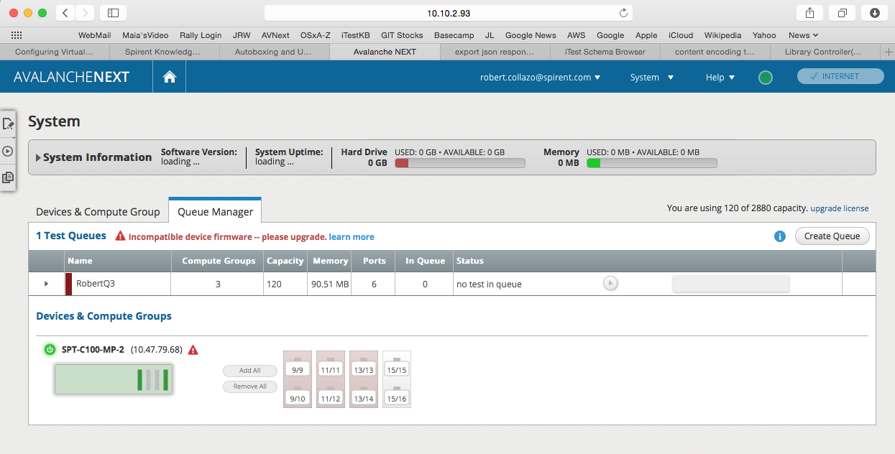
Added Port “Group ID” #13 to Queue: “RobertQ3”
(via) newly Enabled JMeter step
PUT /av_queues/ $AV_QUEUES_Q1_id/add_port_group_id=$AV_CHASSIS_AVPortGroup3_AVPortGroupId

Slide 18
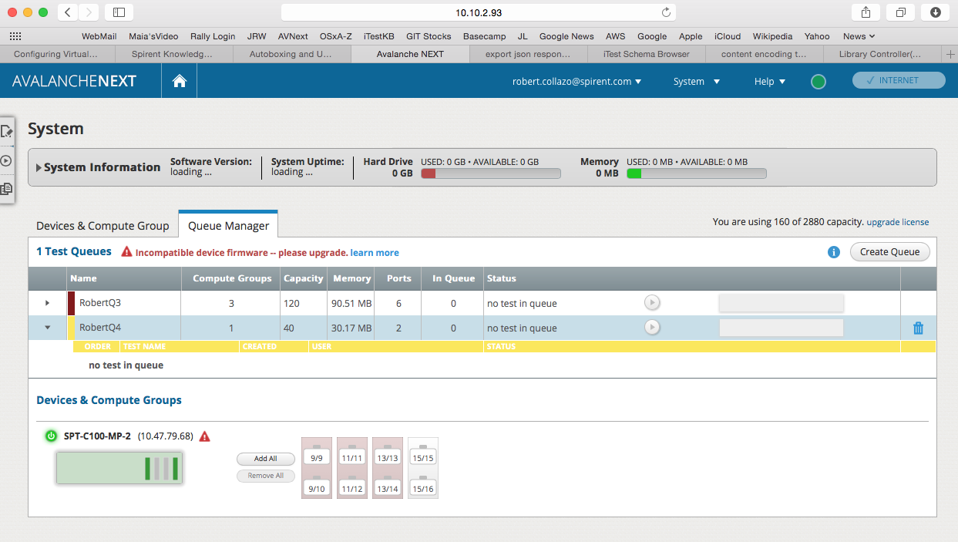
AVNext UI
Added new Test Queue: “RobertQ4”
No Port Group(s) Reserved

Slide 19
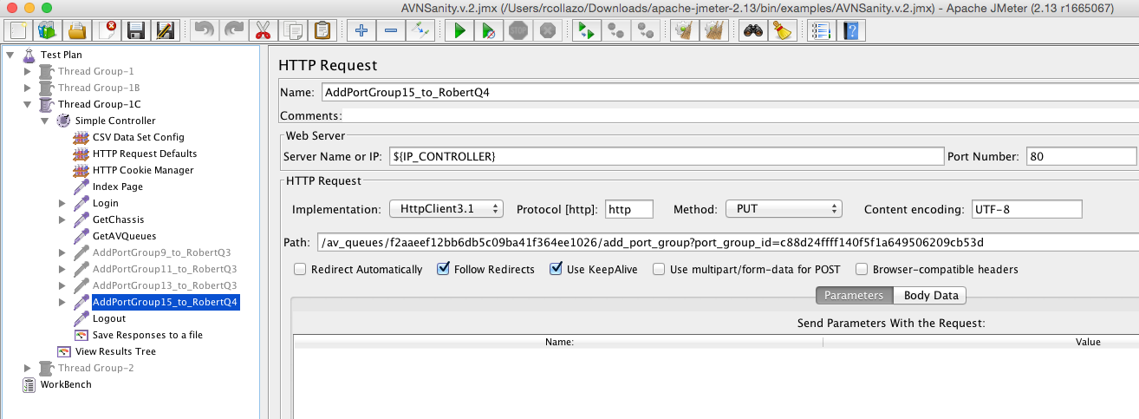
Adding Port “Group ID” #15 to Queue: “RobertQ4”
(via) newly Enabled JMeter step
PUT /av_queues/ $AV_QUEUES_Q2_id/add_port_group_id=$AV_CHASSIS_AVPortGroup4_AVPortGroupId

Slide 20
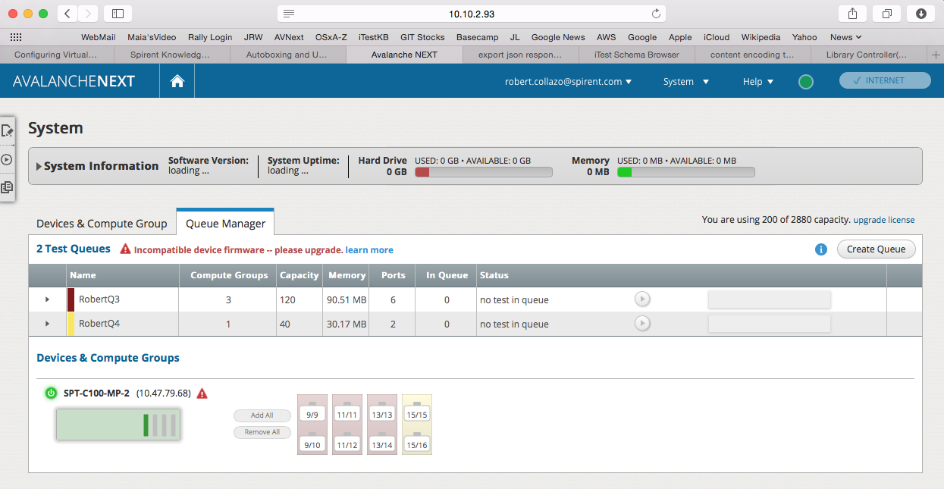
Port “Group ID” #15 now added to Queue: “RobertQ4”

Slide 21
Next (1) Slide: a view of JSON Response to GetChassis API
Displayed in Jmeter’s Response Viewer
Noting detail of Queue status maintained through GetChassis API
Port Group ID #9 . . .

Slide 22
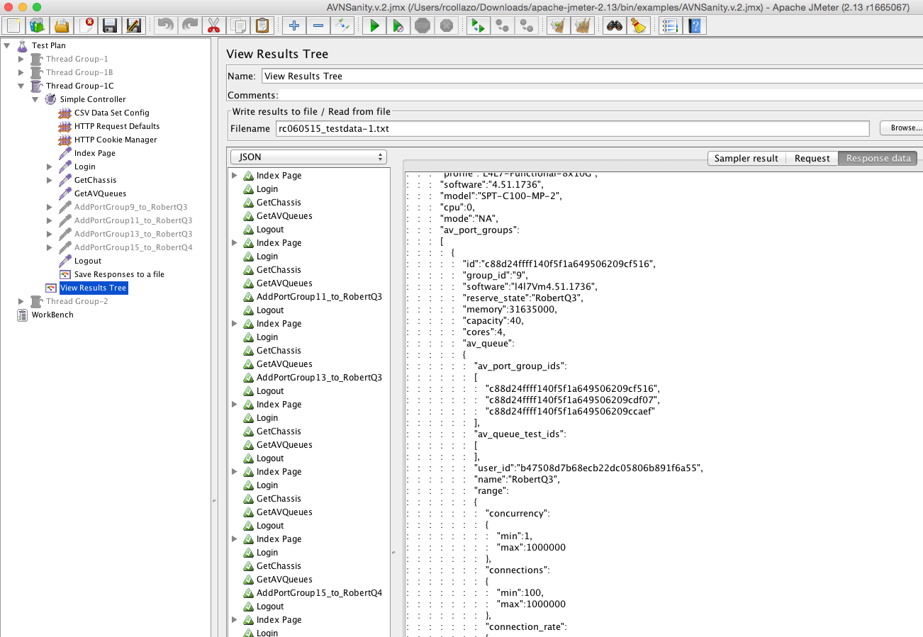

Slide 23
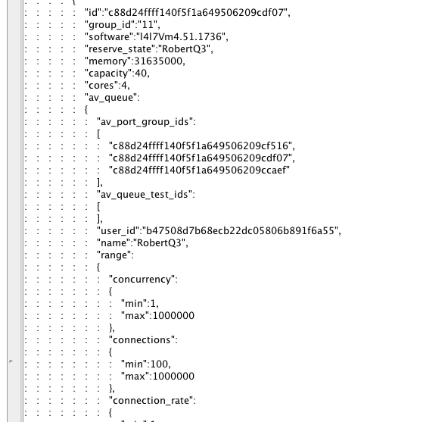
Cont’d: GET /av_chassis JSON Response, Queue info maintained:
Port Group ID #11 . . .

Slide 24
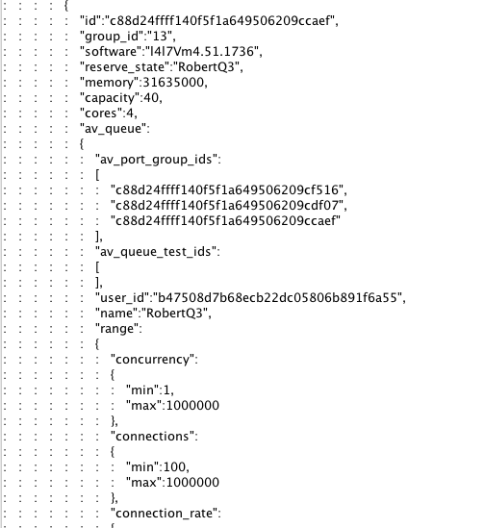
Cont’d: GET /av_chassis JSON Response, Queue info maintained:
Port Group ID #13 . . .

Slide 25
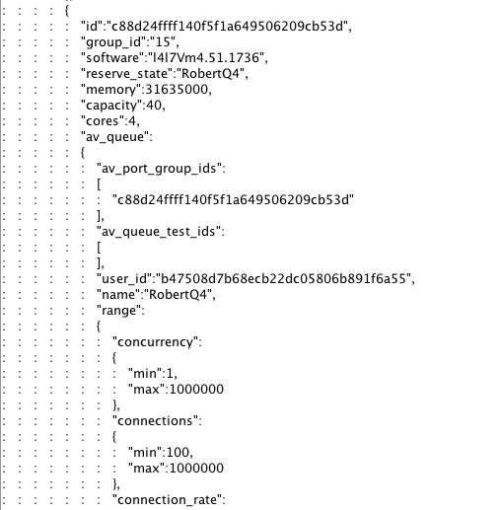
Cont’d: GET /av_chassis JSON Response, Queue info maintained:
Port Group ID #15, in separate Queue “RobertQ4” . . .

